Slide 1

A MATERIAL DESIGN STUDY APP SUBMITTED BY: TEAM MEMBERS 1.SUREGASRI . C (LEADER) 2.RAMPRABHA . J 3.SUHASINI . M 4.VASUNTHARA . R

Slide 2
Enhancing Learning Outcomes: A Comprehensive Study on Material Design in Educational Applications

Slide 3



Introduction to Material Design
In this presentation, we will explore
in educational applications. We will analyze its impact on
and discuss effective strategies for implementation. The goal is to enhance the for
both learners and educators.

Slide 4





Understanding Material Design
refers to a design language developed by Google. It emphasizes the use of
responsive animations, and transitions.
,
This approach aims to create a more
and user experience in educational applications.

Slide 5



Importance of Learning Outcomes
Enhancing is crucial for educational success. It involves improving
, engagement, and overall satisfaction. By focusing on
effective material design, we can create applications that foster a deeper
understanding and among students.

Slide 6
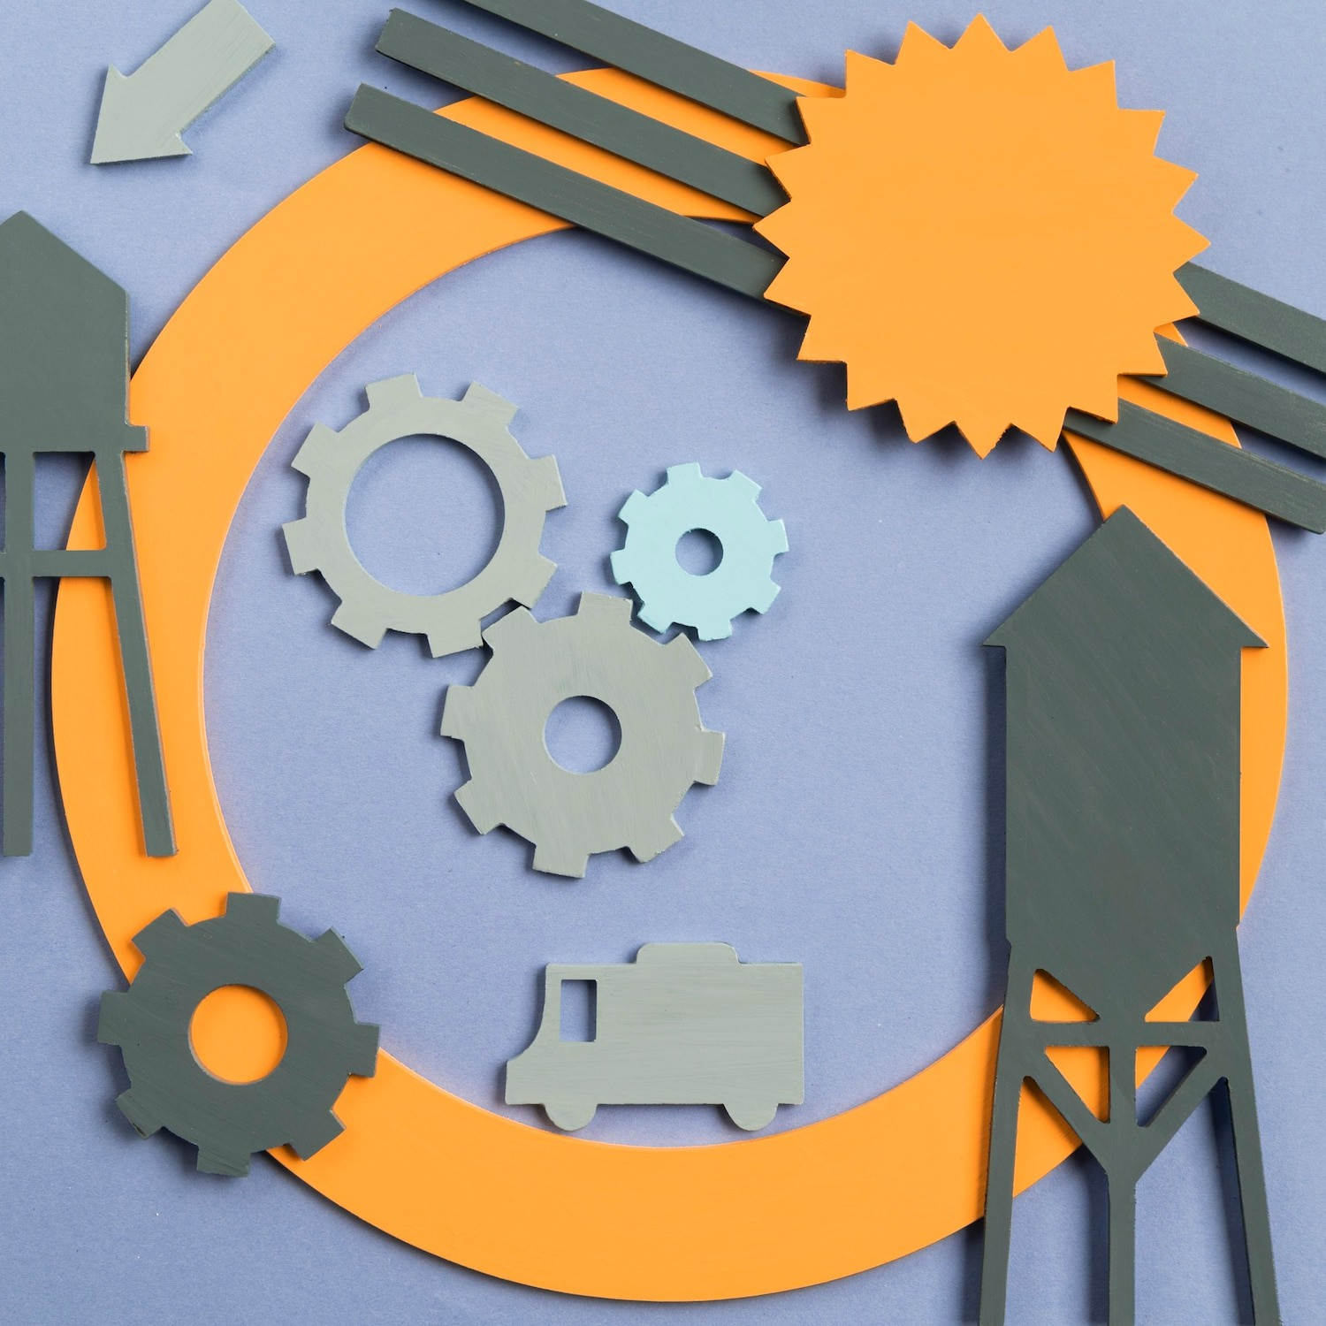



Key Principles of Material Design
The key principles of
include depth, motion, and bold colors.
These elements help create a
interface that guides users intuitively. Understanding these principles is essential for designing educational applications that are both functional and attractive.

Slide 7


A approach is vital in educational applications. It focuses on understanding the needs of learners and educators. By incorporating
and usability testing, designers can create more effective materials that cater to diverse learning styles.

Slide 8



Interactive Learning Experiences
Interactive elements in educational applications, such as , simulations, and gamiﬁcation, signiﬁcantly enhance engagement. By integrating these features into material design, we can create a more learning environment that encourages exploration and curiosity.

Slide 9
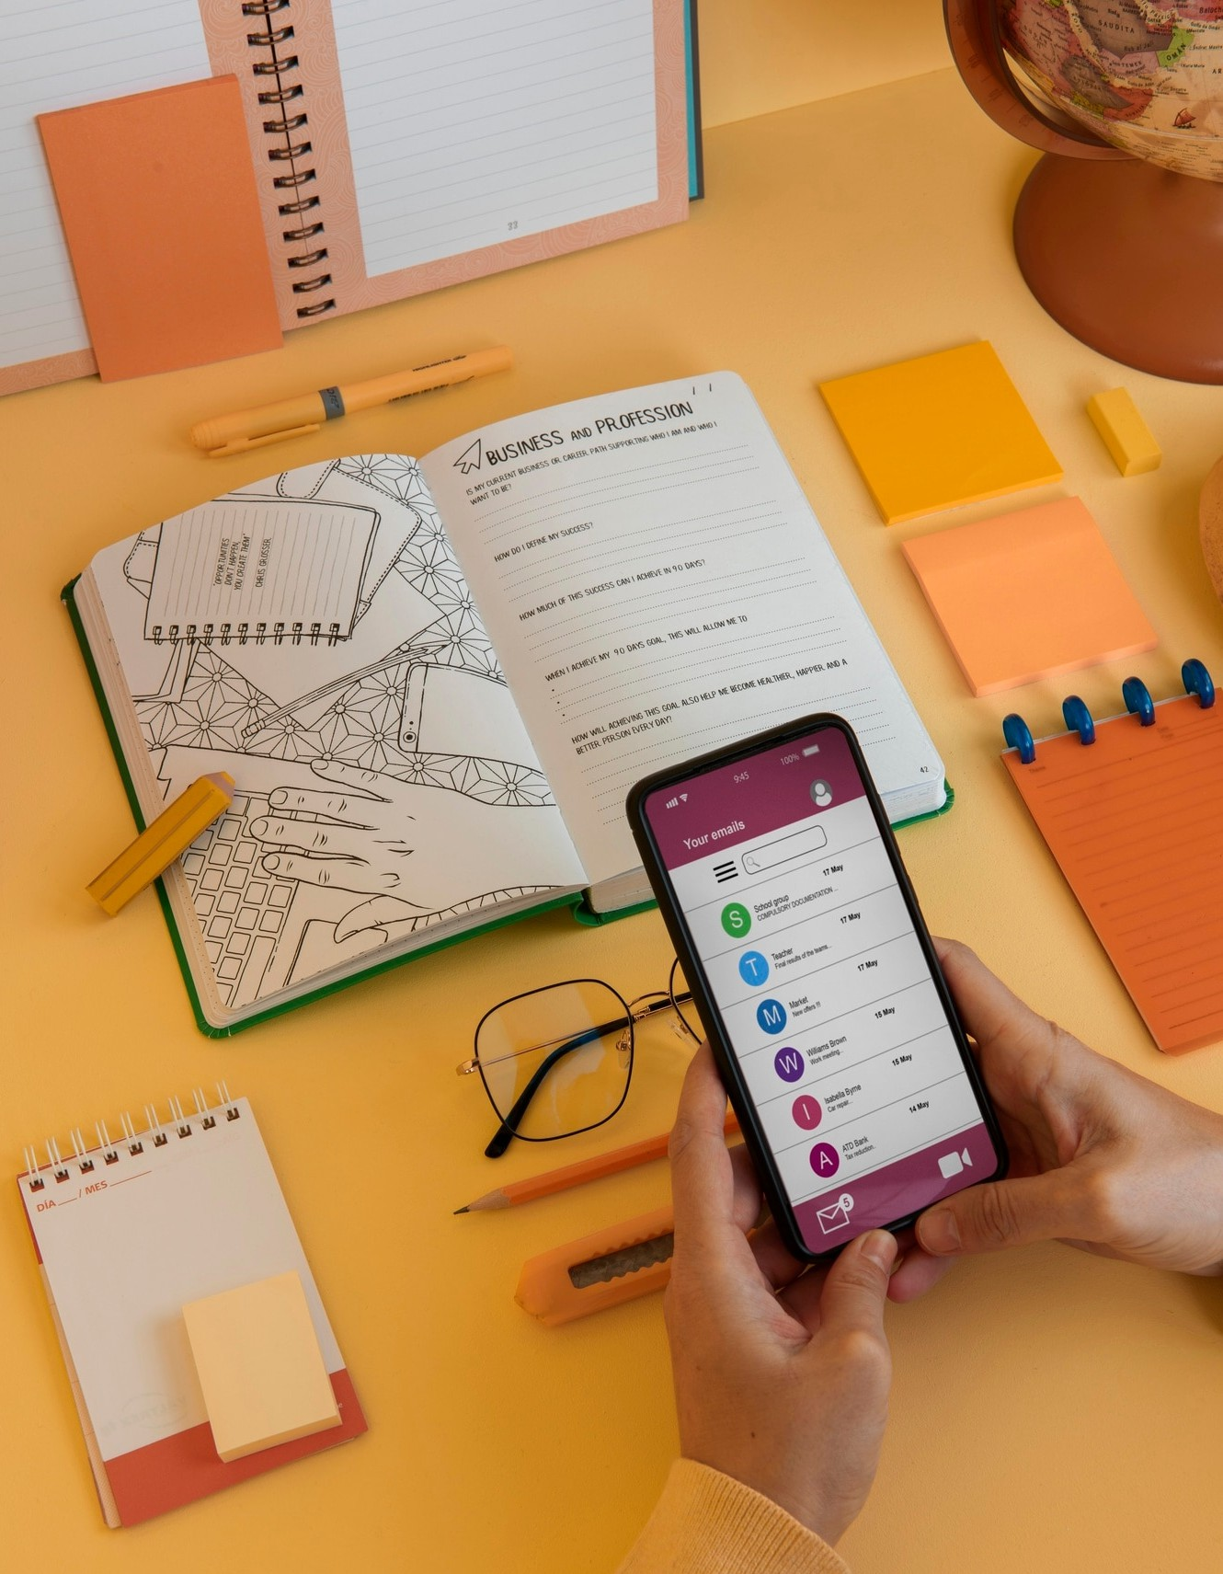


Accessibility Considerations
Ensuring in educational applications is essential. Material design must accommodate users with different abilities, providing equal opportunities for learning. This includes using , alternative text, and adaptable interfaces to support all learners.

Slide 10


Examining successful case studies of material design in educational applications reveals best practices. These examples demonstrate how thoughtful design can lead to improved , retention, and overall educational success.
Learning from these cases can guide future developments.

Slide 11



The future of in education is promising. Trends such as
, personalized learning, and immersive technologies like AR/VR are shaping the landscape. Staying informed about these trends will help educators and designers create innovative solutions.

Slide 12


Conclusion and Recommendations
In conclusion, enhancing learning outcomes through effective material design is achievable. By focusing on
, interactivity, and accessibility, we can create educational applications that truly support learners. Continuous improvement and adaptation are key to success.

Slide 13
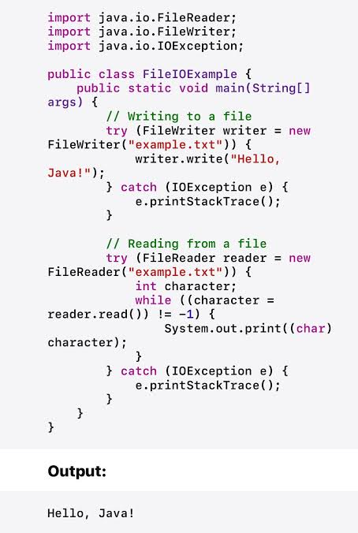


Slide 14


